Slide 1
Game Theory

Slide 2
Game theory
Game theory is basically a branch of mathematics that is used to typical strategic interaction between different players (agents), all of which are equally rational, in a context with predefined rules (of playing or maneuvering) and outcomes.
Every player or agent is a rational entity who is selfish and tries to maximize the reward to be obtained using a particular strategy.
All the players abide by certain rules in order to receive a predefined playoff- a reward after a certain outcome.
Hence, a GAME can be defined as a set of players, actions, strategies, and a final playoff for which all the players are competing.
Notes:
https://www.geeksforgeeks.org/game-theory-in-ai/

Slide 3
Game Theory has now become a describing factor for both Machine Learning algorithms and many daily life situations.
Consider the SVM (Support Vector Machine) for instance. According to Game Theory, the SVM is a game between 2 players where one player challenges the other to find the best hyper-plane after providing the most difficult points for classification.
The final playoff of this game is a solution that will be a trade-off between the strategic abilities of both players competing.

Slide 4
Types of Games
Currently, there are about 5 types of classification of games. They are as follows:
Zero-Sum and Non-Zero Sum Games: In non-zero-sum games, there are multiple players and all of them have the option to gain a benefit due to any move by another player. In zero-sum games, however, if one player earns something, the other players are bound to lose a key playoff.

Slide 5
Simultaneous and Sequential Games: Sequential games are the more popular games where every player is aware of the movement of another player. Simultaneous games are more difficult as in them, the players are involved in a concurrent game. BOARD GAMES are the perfect example of sequential games and are also referred to as turn-based or extensive-form games.
Imperfect Information and Perfect Information Games: In a perfect information game, every player is aware of the movement of the other player and is also aware of the various strategies that the other player might be applying to win the ultimate playoff. In imperfect information games, however, no player is aware of what the other is up to. CARDS are an amazing example of Imperfect information games while CHESS is the perfect example of a Perfect Information game.

Slide 6
Asymmetric and Symmetric Games: Asymmetric games are those win in which each player has a different and usually conflicting final goal. Symmetric games are those in which all players have the same ultimate goal but the strategy being used by each is completely different.
Co-operative and Non-Co-operative Games: In non-co-operative games, every player plays for himself while in co-operative games, players form alliances in order to achieve the final goal.

Slide 7
Nash equilibrium
Nash equilibrium can be considered the essence of Game Theory. It is basically a state, a point of equilibrium of collaboration of multiple players in a game. Nash Equilibrium guarantees maximum profit to each player.
Let us try to understand this with the help of Generative Adversarial Networks (GANs).

Slide 8
What is GAN?
It is a combination of two neural networks: the Discriminator and the Generator.
The Generator Neural Network is fed input images which it analyzes and then produces new sample images, which are made to represent the actual input images as close as possible.
Once the images have been produced, they are sent to the Discriminator Neural Network. This neural network judges the images sent to it and classifies them as generated images and actual input images.
If the image is classified as the original image, the DNN changes its parameters of judging. If the image is classified as a generated image, the image is rejected and returned to the GNN. The GNN then alters its parameters in order to improve the quality of the image produced.

Slide 9
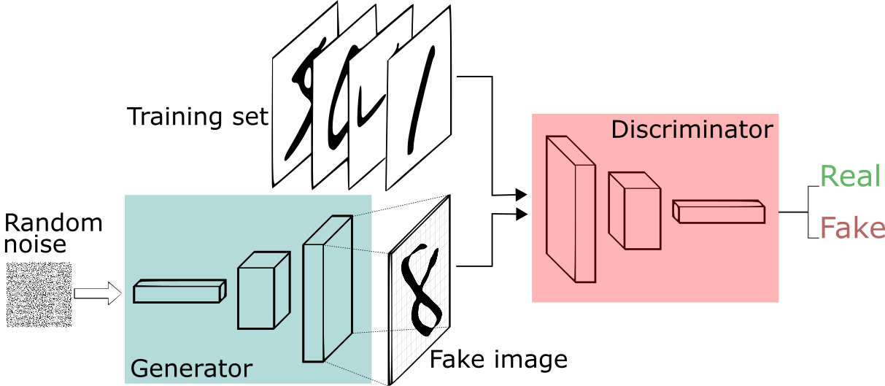

Slide 10
This is a competitive process which goes on until both neural networks do not require to make any changes in their parameters and there can be no further improvement in both neural networks.
This state of no further improvement is known as NASH EQUILIBRIUM.
In other words, GAN is a 2-player competitive game where both players are continuously optimizing themselves to find a Nash Equilibrium.

Slide 11
But how do we know if the game has reached Nash Equilibrium?
In any game, one of the agents is required to disclose their strategy in front of the other agents. After the revelation, if none of the players changes their strategies, it is understood that the game has reached Nash Equilibrium.
Now that we are aware of the basics of Game Theory, let us try to understand how Nash Equilibrium is attained in a simultaneous game. There are many examples but the most famous is the Prisoner’s Dilemma. There are some more examples such as the Closed-bag exchange Game, the Friend or For Game, and the iterated Snowdrift Game.

Slide 12
In all these games, two players are involved and the final playoff is a result of a decision that has to be made by both players.
Both players have to make a choice between defection and co-operation. If both players cooperate, the final playoff will turn out to be positive for both. However, if both defect, the final playoff will be negative for both players. If there is a combination of one player defecting and the other co-operating, the final playoff will be positive for one and negative for another.
Here, Nash Equilibrium plays an important role. Only if both players jot out a strategy that benefits each other and provide both with a positive playoff, the solution to this problem will be optimal.

Slide 13
Where is GAME THEORY now?
Game Theory is increasingly becoming a part of the real-world in its various applications in areas like public health services, public safety, and wildlife.
Currently, game theory is being used in adversary training in GANs, multi-agent systems, and imitation and reinforcement learning.
In the case of perfect information and symmetric games, many Machine Learning and Deep Learning techniques are applicable.
The real challenge lies in the development of techniques to handle incomplete information games, such as Poker. The complexity of the game lies in the fact that there are too many combinations of cards and the uncertainty of the cards being held by the various players.

Slide 14
Example: the Prisoner’s Dilemma
One of the most well-known strategic games is the Prisoner’s Dilemma.
Its name comes from a story involving suspects in a crime;
Its importance comes from the huge variety of situations in which the participants face incentives similar to those faced by the suspects in the story.

Slide 15
Prisoner’s Dilemma
Two suspects in a major crime are held in separate cells.
There is enough evidence to convict each of them of a minor offense, but not enough evidence to convict either of them of the major crime unless one of them acts as an informer against the other (finks).
If they both stay quiet, each will be convicted of the minor offense and spend one year in prison.
If one and only one of them finks, she will be freed and used as a witness against the other, who will spend four years in prison.
If they both fink, each will spend three years in prison.

Slide 16
Prisoner’s Dilemma
This situation may be modelled as a strategic game:
Players The two suspects.
Actions Each player’s set of actions is {Quiet, Fink}.
Preferences Suspect 1’s ordering of the action profiles, from best to worst, is (Fink, Quiet) (she finks and suspect 2 remains quiet, so she is freed), (Quiet,Quiet) (she gets one year in prison), (Fink, Fink) (she gets three years in prison),(Quiet, Fink) (she gets four years in prison).
Suspect 2’s ordering is (Quiet, Fink),(Quiet, Quiet), (Fink, Fink), (Fink, Quiet).

Slide 17
Prisoner’s Dilemma
We can represent the game compactly in a table.
First choose payoff functions that represent the suspects’ preference orderings. For suspect 1 we need a function u1 for which
u1(Fink, Quiet) > u1(Quiet, Quiet) > u1(Fink, Fink) > u1(Quiet, Fink).

Slide 18
Prisoner’s Dilemma
A simple specification is
u1(Fink, Quiet) = 3,
u1(Quiet, Quiet) = 2,
u1(Fink, Fink) =1, and
u1(Quiet, Fink) = 0.
For suspect 2 we can similarly choose the function u2 for which:
u2(Quiet, Fink) = 3,
u2(Quiet, Quiet) = 2,
u2(Fink, Fink) = 1, and
u2(Fink, Quiet) = 0

Slide 19
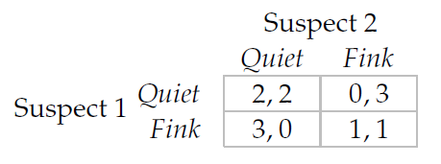
Prisoner’s Dilemma
In this table the two rows correspond to the two possible actions of player 1, the two columns correspond to the two possible actions of player 2, and the numbers in each box are the players’ payoffs to the action profile to which the box corresponds, with player 1’s payoff listed first.

Slide 20
By examining the four possible pairs of actions in the Prisoner’s Dilemma ,we see that (Fink, Fink) is the unique Nash equilibrium because:
given that player 2 chooses Fink, player 1 is better off choosing Fink than Quiet (looking at the right column of the table we see that Fink yields player 1 a payoff of 1 whereas Quiet yields her a payoff of 0)
given that player 1 chooses Fink, player 2 is better off choosing Fink than Quiet (looking at the bottom row of the table we see that Fink yields player 2 a payoff of 1 whereas Quiet yields her a payoff of 0).

Slide 21
No other action profile is a Nash equilibrium:
(Quiet, Quiet) - when player 2 chooses Quiet,
player 1’s payoff to Fink exceeds her payoff to Quiet (look at the first components of the entries in the left column of the table).
Further, when player 1 chooses Quiet, player 2’s payoff to Fink exceeds her payoff to Quiet: player 2, as well as player 1, wants to deviate.
To show that a pair of actions is not a Nash equilibrium, however, it is not necessary to study player 2’s decision once we have established that player 1 wants to deviate: it is enough to show that one player wishes to deviate to show that a pair of actions is not a Nash equilibrium.

Slide 22
No other action profile is a Nash equilibrium:
(Fink, Quiet) -- when player 1 chooses Fink, player 2’s payoff to Fink exceeds her payoff to Quiet (look at the second components of the entries in the bottom row of the table).
(Quiet, Fink) -- when player 2 chooses Fink, player 1’s payoff to Fink exceeds her payoff to Quiet (look at the first components of the entries in the right column of the table).

Slide 23
many other situations have similar structures. the Prisoner’s Dilemma models the situation that the players face. Some examples follow.
Working on a joint project
Duopoly
The arms race
Common property

Slide 24
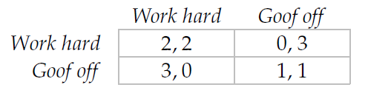
Working on a joint project
You are working with a friend on a joint project.
Each of you can either work hard or goof off.
If your friend works hard then you prefer to goof off (the outcome of the project would be better if you worked hard too, but the increment in its value to you is not worth the extra effort).
You prefer the outcome of your both working hard to the outcome of your both goofing off (in which case nothing gets accomplished),
and the worst outcome for you is that you work hard and your friend goofs off (you hate to be “exploited”).
If your friend has the same preferences then the game that models the situation you face is given in Figure below, which, as you can see, differs from the Prisoner’s Dilemma only in the names of the actions.

Slide 25
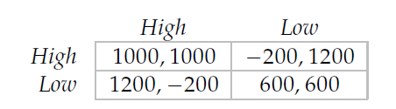
Duopoly
In a simple model of a duopoly, two firms produce the same good, for which each firm charges either a low price or a high price. Each firm wants to achieve the highest possible profit.
If both firms choose High then each earns a profit of $1000.
If one firm chooses High and the other chooses Low then the firm choosing High obtains no customers and makes a loss of $200, whereas the firm choosing Low earns a profit of $1200 (its unit profit is low, but its volume is high).
If both firms choose Low then each earns a profit of $600.
Each firm cares only about its profit, so we can represent its preferences by the profit it obtains, yielding the game in Figure .

Slide 26
The arms race
Under some assumptions about the countries’ preferences, an arms race can be modeled as the Prisoner’s Dilemma.
Assume that each country can build an arsenal of nuclear bombs, or can refrain from doing so.
Assume also that each country’s favorite outcome is that it has bombs and the other country does not;
the next best outcome is that neither country has any bombs;
the next best outcome is that both countries have bombs (what matters is relative strength, and bombs are costly to build);
and the worst outcome is that only the other country has bombs.
In this case the situation is modeled by the Prisoner’s Dilemma, in which the action Don’t build bombs corresponds to Quiet in and the action Build bombs corresponds to Fink.

Slide 27
In the Prisoner’s Dilemma the main issue is whether or not the players will cooperate(choose Quiet).
In the following game the players agree that it is better to cooperate than not to cooperate, but disagree about the best outcome.

Slide 28
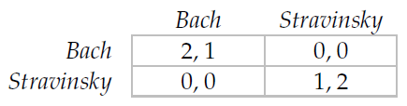
Example: Bach or Stravinsky?
Two people wish to go out together. Two concerts are available: one of music by Bach, and one of music by Stravinsky. One person prefers Bach and the other prefers Stravinsky. If they go to different concerts, each of them is equally unhappy listening to the music of either composer.
We can model this situation as the two-player strategic game in which the person who prefers Bach chooses a row and the person who prefers Stravinsky chooses a column.

Slide 29
Like the Prisoner’s Dilemma, BoS models a wide variety of situations.
Consider, for example, two officials of a political party deciding the stand to take on an issue. Suppose that they disagree about the best stand, but are both better off if they take the same stand than if they take different stands; both cases in which they take different stands, in which case voters do not know what to think, are equally bad. Then BoS captures the situation they face.
Or consider two merging firms that currently use different computer technologies. As two divisions of a single firm they will both be better off if they both use the same technology; each firm prefers that the common technology be the one it used in the past. BoS models the choices the firms face.

Slide 30
Nash equilibria of BoS
(Bach, Bach): If player 1 switches to Stravinsky then her payoff decreases from 2 to 0; if player 2 switches to Stravinsky then her payoff decreases from 1 to 0. Thus a deviation by either player decreases her payoff. Thus (Bach, Bach) is a Nash equilibrium.
(Bach, Stravinsky): If player 1 switches to Stravinsky then her payoff increases from 0 to 1. Thus (Bach, Stravinsky) is not a Nash equilibrium. (Player 2 can increase her payoff by deviating, too, but to show the pair is not a Nash equilibrium it suffices to show that one player can increase her payoff by deviating.)
(Stravinsky, Bach): If player 1 switches to Bach then her payoff increases from 0 to 2. Thus (Stravinsky, Bach) is not a Nash equilibrium.
(Stravinsky, Stravinsky): If player 1 switches to Bach then her payoff decreases from 1 to 0; if player 2 switches to Bach then her payoff decreases from 2 to 0. Thus a deviation by either player decreases her payoff. Thus (Stravinsky, Stravinsky) is a Nash equilibrium.

Slide 31
Aspects of both conflict and cooperation are present in both the Prisoner’s Dilemma and BoS. The next game is purely conflictual.

Slide 32
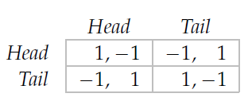
Example: Matching Coins
Two people choose, simultaneously, whether to show the Head or the Tail of a coin.
If they show the same side, person 2 pays person 1 a dollar;
if they show different sides, person 1 pays person 2 a dollar.
Each person cares only about the amount of money she receives, and (naturally!) prefers to receive more than less.
A strategic game that models this situation is shown in Figure (In this representation of the players’ preferences, the payoffs are equal to the amounts of money involved. We could equally well work with another representation—for example, 2 could replace each 1, and 1 could replace each −1.)

Slide 33
Example: Matching Coins
In this game the players’ interests are diametrically opposed (such a game is called “strictly competitive”): player 1 wants to take the same action as the other player, whereas player 2 wants to take the opposite action.

Slide 34
Example: Matching Coins
This game may, for example, model the choices of appearances for new products by an established producer and a new firm in a market of fixed size. Suppose that each firm can choose one of two different appearances for the product. The established producer prefers the newcomer’s product to look different from its own (so that its customers will not be tempted to buy the newcomer’s product), whereas the newcomer prefers that the products look alike.
Or the game could model a relationship between two people in which one person wants to be like the other, whereas the other wants to be different.

Slide 35
Nash equilibria of Matching Coins
By checking each of the four pairs of actions in Matching coins we see that the game has no Nash equilibrium.
(Head, Head): player 2 is better off deviating;
(Tail, Tail): player 2 is better off deviating
(Head, Tail): player 1 is better off deviating
(Tail, Head) : player 1 is better off deviating

Slide 36
Example: the Stag Hunt
A group of hunters wish to catch a stag(a male deer).
Each of a group of hunters has two options:
she may remain attentive to the pursuit of a stag, or catch a hare.
If all hunters pursue the stag, they catch it and share it equally;
if any hunter devotes her energy to catching a hare, the stag escapes, and the hare belongs to the defecting hunter alone.
Each hunter prefers a share of the stag to a hare.

Slide 37
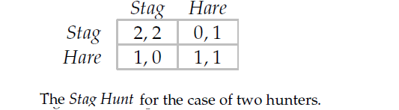
Example: the Stag Hunt
The strategic game that corresponds to this specification is:
Players The hunters.
Actions Each player’s set of actions is {Stag, Hare}.
Preferences For each player, the action profile in which all players choose Stag (resulting in her obtaining a share of the stag) is ranked highest, followed by any profile in which she chooses Hare (resulting in her obtaining a hare), followed by any profile in which she chooses Stag and one or more of the other players chooses Hare (resulting in her leaving empty-handed).

Slide 38
Nash equilibria of The Stag Hunt
The two-player Stag Hunt has two Nash equilibria:(Stag, Stag) and (Hare, Hare).
If one player remains attentive to the pursuit of the stag, then the other player prefers to remain attentive; if one player chases a hare, the other one prefers to chase a hare (she cannot catch a stag alone).

Slide 39
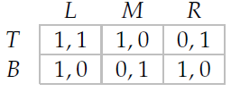
Strict and nonstrict equilibria
In all the Nash equilibria of the games we have studied so far a deviation by a player leads to an outcome worse for that player than the equilibrium outcome.
Consider the game in Figure. This game has a unique Nash equilibrium, namely (T, L). (For every other pair of actions, one of the players is better off changing her action.)
When player 2 chooses L, as she does in this equilibrium, player 1 is equally happy choosing T or B; if she deviates to B then she is no worse off than she is in the equilibrium. We say that the Nash equilibrium (T, L) is not a strict equilibrium.
For a general game, an equilibrium is strict if each player’s equilibrium action is better than all her other actions, given the other players’ actions.

Slide 40
Dominated actions
Strict domination
You drive up to a red traffic light. The left lane is free; in the right lane there is a car that may turn right when the light changes to green, in which case it will have to wait for a pedestrian to cross the side street.
Assuming you wish to progress as quickly as possible, the action of pulling up in the left lane “strictly dominates” that of pulling up in the right lane.
If the car in the right lane turns right then you are much better off in the left lane, where your progress will not be impeded; and even if the car in the right lane does not turn right, you are still better off in the left lane, rather than behind the other car.
In any game, a player’s action “strictly dominates” another action if it is superior, no matter what the other players do.

Slide 41
Dominated actions
In the Prisoner’s Dilemma, for example, the action Fink strictly dominates the action Quiet: regardless of her opponent’s action, a player prefers the outcome when she chooses Fink to the outcome when she chooses Quiet.
In BoS, on the other hand, neither action strictly dominates the other: Bach is better than Stravinsky if the other player chooses Bach, but is worse than Stravinsky if the other player chooses Stravinsky.

Slide 42
Dominated actions
Weak domination
As you approach the red light in the previous situation there is a car in each lane.
The car in the right lane may, or may not, be turning right; if it is, it may be delayed by a pedestrian crossing the side street.
The car in the left lane cannot turn right. In this case your pulling up in the left lane “weakly dominates”, though does not strictly dominate, your pulling up in the right lane.
If the car in the right lane does not turn right, then both lanes are equally good; if it does, then the left lane is better.

Slide 43
Cournot’s model of oligopoly
How does the outcome of competition among the firms in an industry depend on the characteristics of the demand for the firms’ output, the nature of the firms’ cost functions, and the number of firms?
Will the benefits of technological improvements be passed on to consumers?
Will a reduction in the number of firms generate a less desirable outcome?
To answer these questions we need a model of the interaction between firms competing for the business of consumers.

Slide 44
A single good is produced by n firms.
The cost to firm i of producing qi units of the good is Ci(qi), where Ci is an increasing function (more output is more costly to produce).
All the output is sold at a single price, determined by the demand for the good and the firms’ total output

